Slide 1
Network Intrusion Detection
CAPSTONE PROJECT
Presented By:
HARINI.P.S
SRM INSTITUTE OF SCIENCE AND TECHNOLOGY
ELECTRONICS AND COMMUNICATION DEPARTMENT

Slide 2
OUTLINE
Problem Statement (Should not include solution)
Proposed System/Solution
System Development Approach (Technology Used)
Algorithm & Deployment
Result (Output Image)
Conclusion
Future Scope
References

Slide 3
Problem Statement
Create a robust network intrusion detection system (NIDS) using machine learning. The system should be capable of analyzing network traffic data to identify and classify various types of cyber-attacks (e.g., DoS, Probe, R2L, U2R) and distinguish them from normal network activity. The goal is to build a model that can effectively secure communication networks by providing an early warning of malicious activities..

Slide 4
Proposed Solution
The proposed system aims to address the challenge of predicting the required analyze network traffic data to identify and classify various types of cyber-attacks (e.g., DoS, Probe, R2L, U2R) and distinguish them from normal network activity. This involves leveraging data analytics and machine learning techniques to forecast demand patterns accurately. The solution will consist of the following components:
Data Collection(FROM KAGGLE TEST_DATA)
22544 rows: Each row represents a single network connection/session.
41 columns: Each column represents a feature extracted from that connection.
Data Preprocessing:
Clean and preprocess the collected data to handle missing values, outliers, and inconsistencies.
Feature engineering to extract relevant features from the data that might impact identifying the various types of cyber attacks.
Machine Learning Algorithm:
Implement a machine learning algorithm, such that it predicts the TCP (Transmission Control Protocol) flags that indicate control information about the state or purpose of a packet within a TCP connection.
Deployment:
Develop a user-friendly interface or application that provides real-time predictions of the network analysis
Deploy the solution on a scalable and reliable platform, considering factors .
Evaluation:
Assess the model's performance using appropriate metrics such as Precision (Positive Predictive Value), True Positive Rate ,Sensitivity, Detection Rate and other related metrics.
Fine-tune the model based on continuous monitoring of prediction accuracy.

Slide 5
System Approach
The "System Approach" section outlines the overall strategy and methodology for developing and implementing the NETWORK INTRUSION DETECTION
IBM CLOUD
IBM WATSONX.AI STUDIO
TEST_DATA ( DATA SET FROM KAGGLE)

Slide 6
Algorithm & Deployment
:
Algorithm Selection:
Algorithm is taken over by ibm watsonx.ai , ml models and such a qlgorithm is created automatically
Data Input:
Downloaded the data set via KAGGLE and loaded for the data set analysis in the model.
Training Process:
Alogorithm is trained auto AI experiment such that it gives us the Pipelines for the best prediction made out our choice according to our problem.
Prediction Process:
The project as been predicted via flag typically refers to TCP (Transmission Control Protocol) flags that indicate control information about the state or purpose of a packet within a TCP connection.

Slide 7
Result
Evaluate the machine learning model based on its accuracy and ability to classify network traffic into normal activity or various cyber-attack categories, including DoS, Probe, R2L, and U2R. The model aims to strengthen communication network security by detecting threats early.

Slide 8
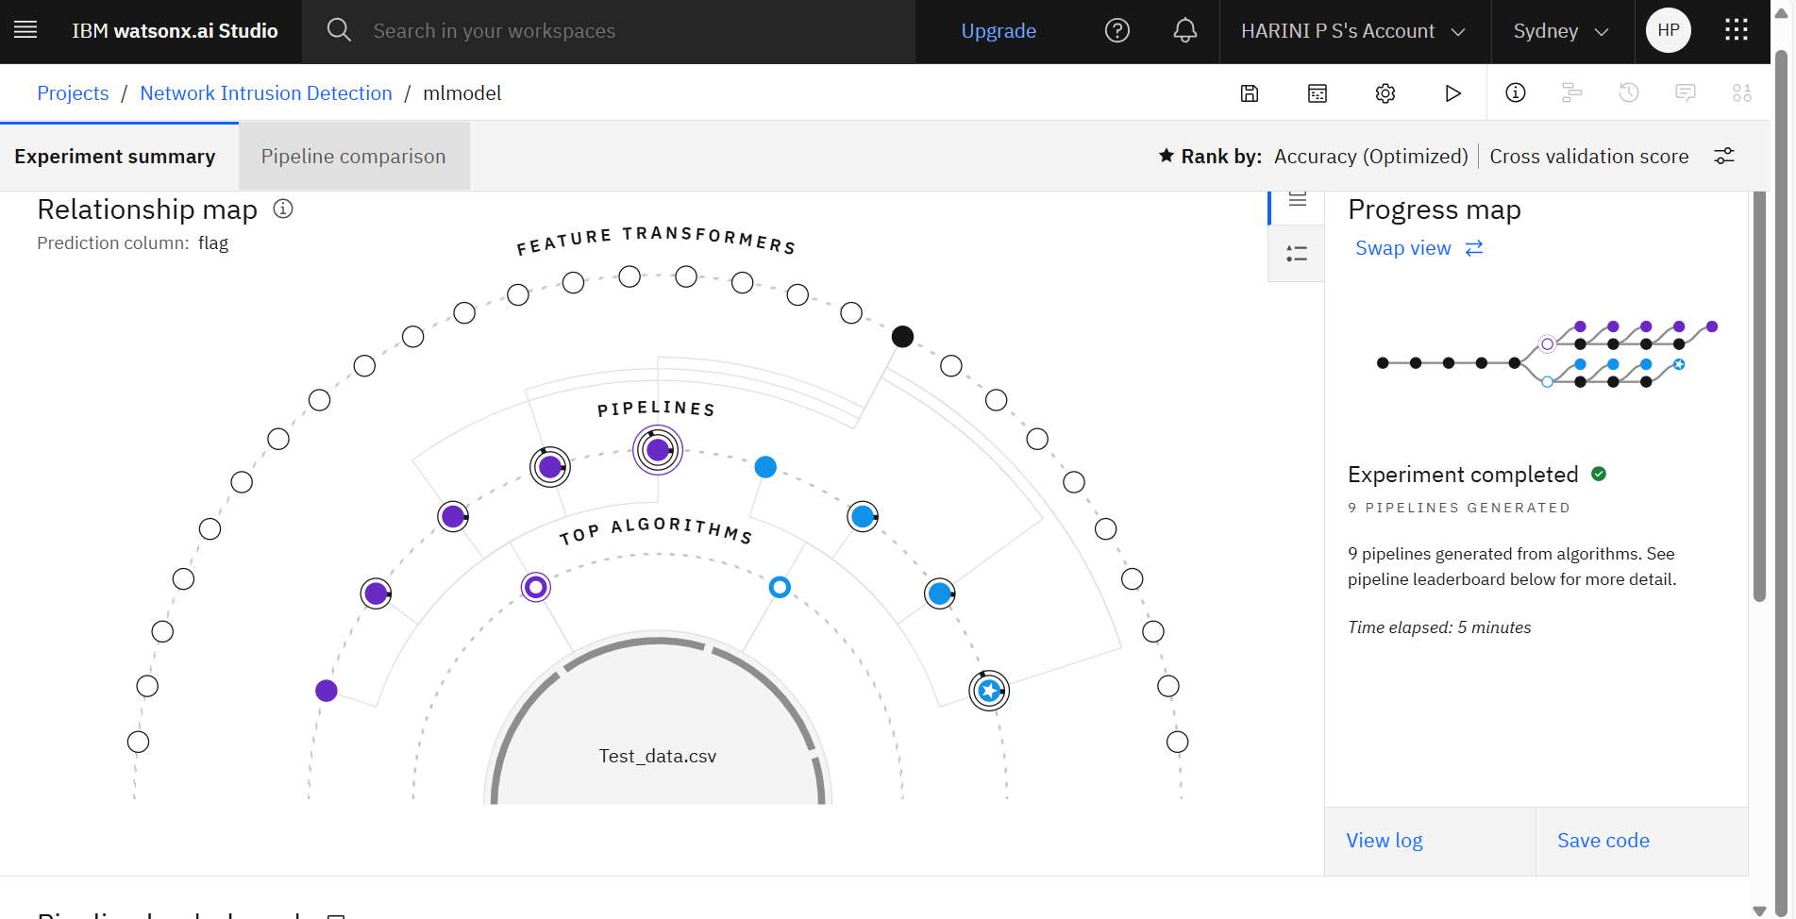
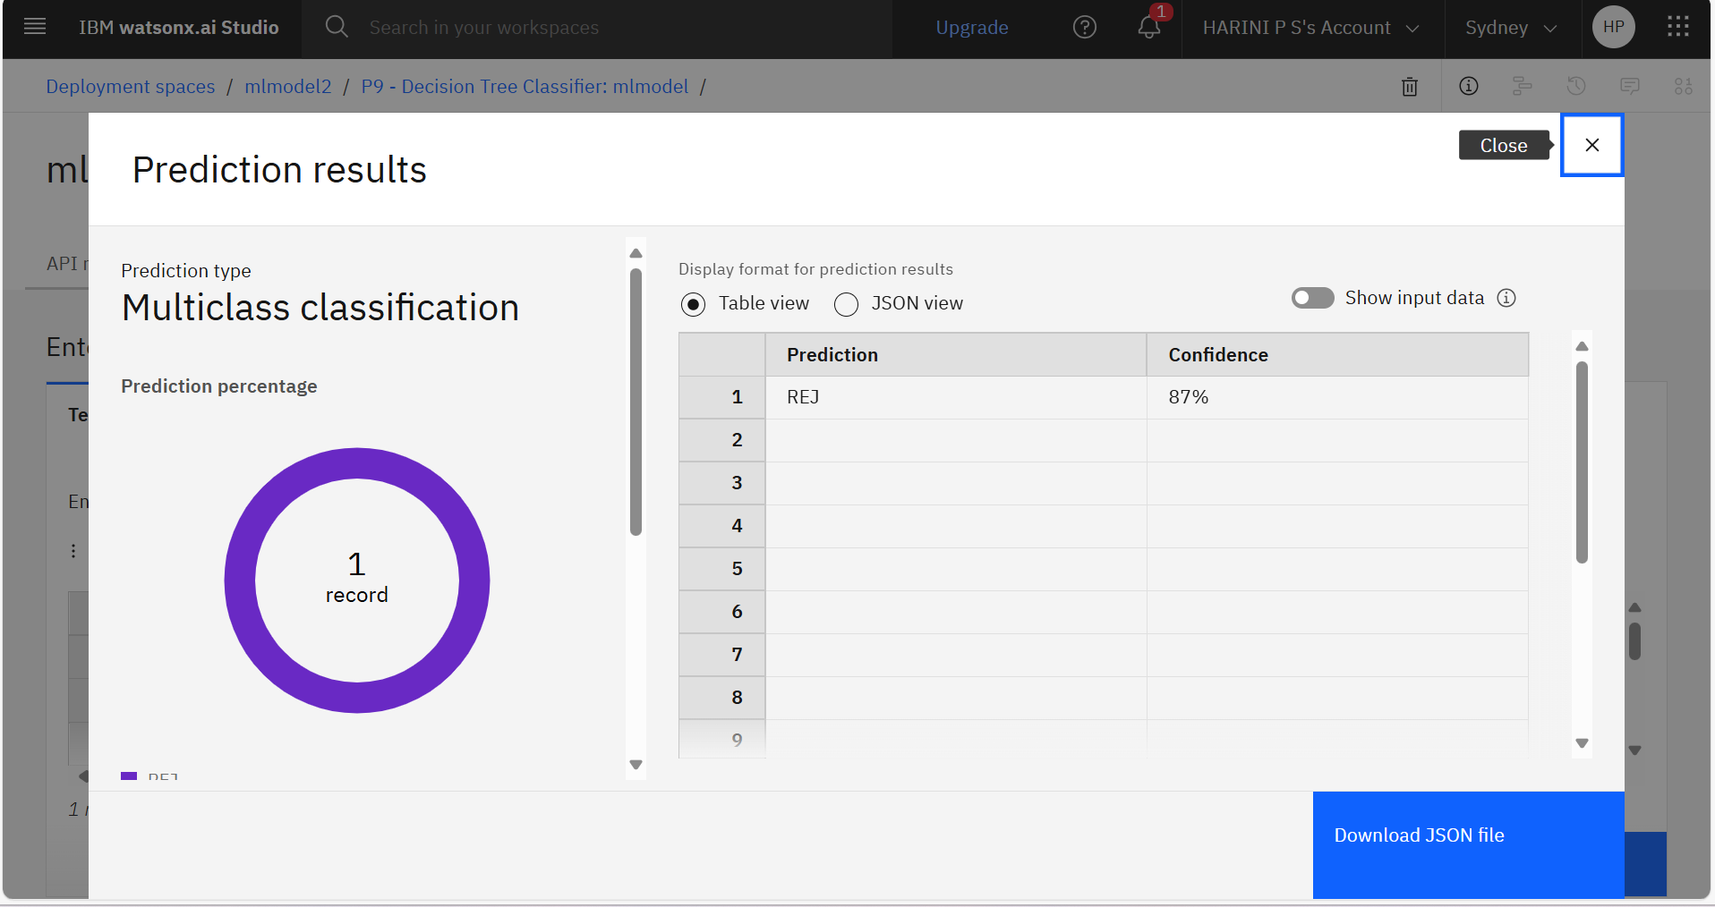
Results proof

Slide 9
Conclusion
Assess the performance of the machine learning model by measuring its accuracy and effectiveness in distinguishing between normal network behavior and different types of cyber-attacks, such as DoS, Probe, R2L, and U2R. The primary goal of the model is to enhance the security of communication networks by providing timely detection of potential threats..

Slide 10
Future scope
Incorporation of Deep Learning Models Future work can integrate deep learning architectures such as LSTM, GRU, or Transformer-based models to better capture temporal patterns in network traffic, potentially improving detection rates for complex or evolving attacks.
Real-Time Intrusion Detection Transitioning from offline analysis to real-time intrusion detection is a key goal. By deploying the model in real-time environments, it can continuously monitor live traffic and respond to threats instantly.
Adaptive Learning for Evolving Threats Incorporating online or incremental learning techniques would enable the model to adapt to new, unseen types of cyber-attacks without requiring complete retraining, ensuring long-term usability in dynamic network environments.
Improved Detection of Rare Attack Types (e.g., U2R, R2L) Future models can focus on addressing class imbalance through advanced techniques such as data augmentation, synthetic sample generation (SMOTE, GANs), or anomaly-based hybrid models to better detect underrepresented attack types.
Deployment in Diverse Network Architectures The system can be tested and deployed in different infrastructures such as IoT, Cloud, or Software-Defined Networks (SDNs) to evaluate performance under various traffic patterns and security challenges.

Slide 11
References
1. Machine Learning for Network Intrusion Detection—A Comparative Study
Compares Random Forest, SVM, Naive Bayes, and Logistic Regression using CICIDS‑2017. RF + SMOTE achieved a 97% detection rate for modern attack types. Reddit+12MDPI+12MDPI+12
2. Deep Learning‑based Intrusion Detection Systems: A Survey (Apr 2025)
A comprehensive survey outlining DL-based IDS workflows: data collection, modeling, tuning, evaluation—covering benchmark datasets and challenges.

Slide 12
Github link
https://github.com/harinips12/ibmprojectfinal

Slide 13
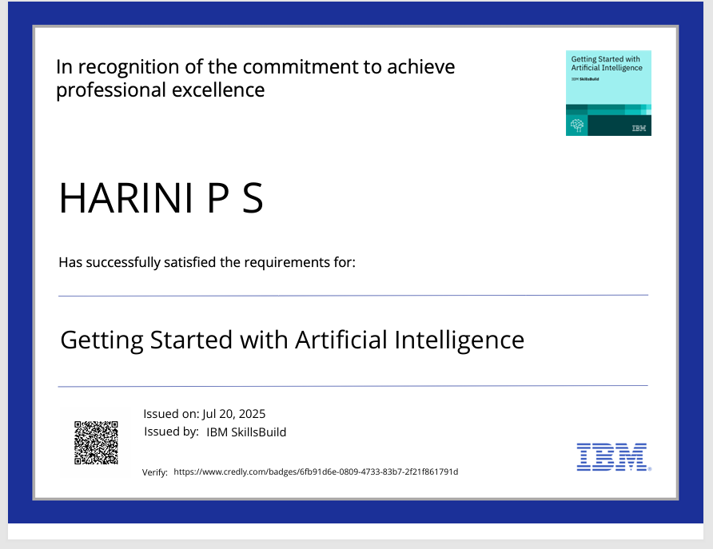
IBM Certifications
Screenshot/ credly certificate( getting started with AI)

Slide 14

IBM Certifications
Screenshot/ credly certificate( Journey to Cloud)

Slide 15

IBM Certifications
Screenshot/ credly certificate( RAG Lab)

Slide 16
THANK YOU

